Slide 1
Al-RAJHI BANK
ABDULELAH IBRAHIM ALFAISAL

Slide 2
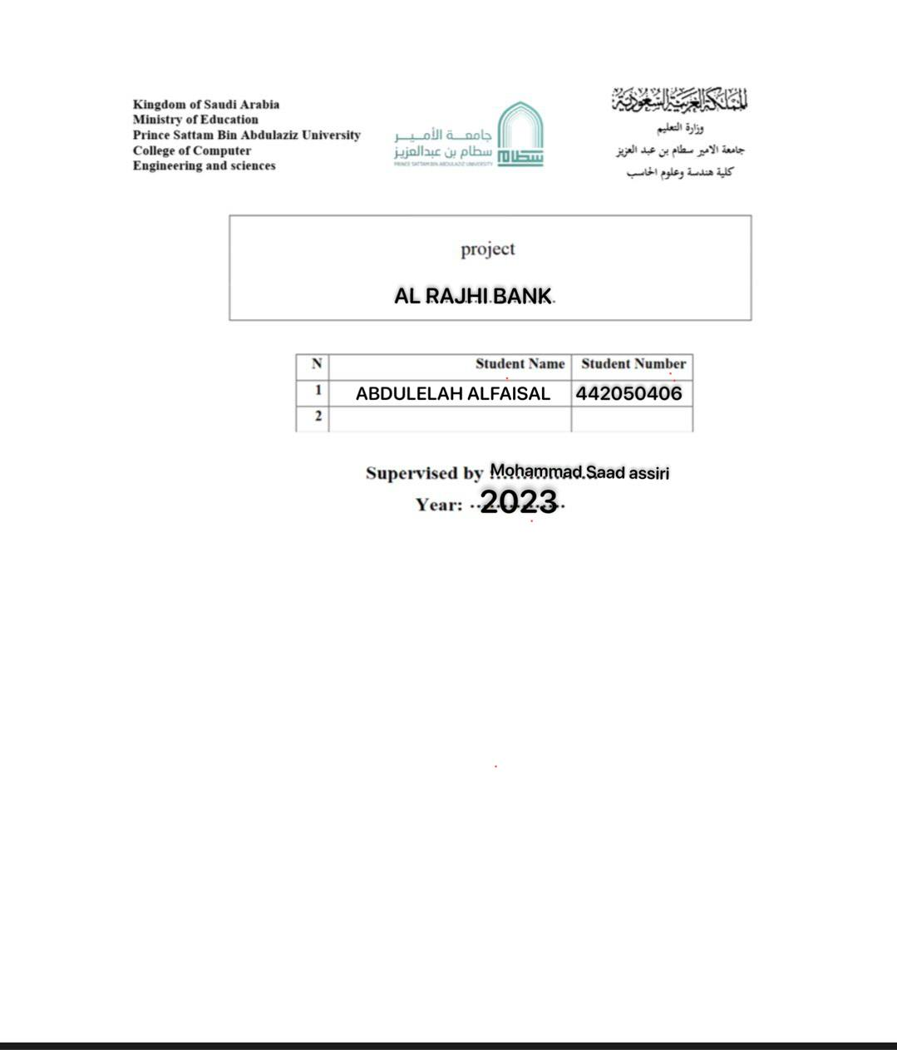

Slide 3

Introduction
Al-Rajhi Bank application is a banking application that provides bank customers with various and easy-to-use banking services via smart phones. I will talk about the problems and how they were solved, a background on the program, some functional and non-functional requirements, a work plan, and other things for this application

Slide 4
Problems
There are some problems encountered by Al-Rajhi application, problems in making bank transfers that are either delayed or wrong, problems creating an account or forgetting the password to log in

Slide 5
Background
Al Rajhi App is a banking application that allows users to manage their bank accounts and perform online banking transactions easily and securely. Many services are provided through Al-Rajhi bank application, including Managing bank accounts, bank transfers, electronic payment and other banking services. Al Rajhi bank app is easy to use and has a simple and clear design

Slide 6

Proposed solution
1- Improve the speed and efficiency of the application by updating and developing the algorithms used in it.
2- Improve the user interface to facilitate the use of the application and make it more attractive.
3- Add new features, such as continuous updates of exchange rates and changing interest rates , and providing advanced analytical tools to help customers make the right financial decisions.
4- Enhance security by using modern techniques to verify the user's identity and protect their personal data.
5- Improve the quality of service through the application and provide effective and responsive customer service to meet the needs of users.

Slide 7
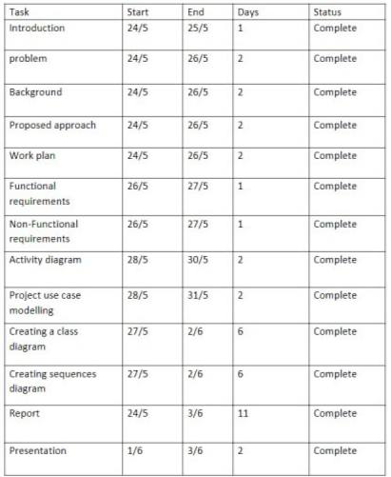
Work plan

Slide 8
Functional requirements
Secure login: The application must have a secure login system that protects user data and prevents unauthorized access.
Balance and account management: The application should be able to display user balances and manage their accounts, including opening new accounts and closing old ones.
Financial transfers: The application must allow users to transfer money between their own accounts or to others, in an easy and secure manner.
Electronic payments: The application must be compatible with common electronic payment systems and allow users to pay bills or make purchases online.
Notifications and alerts: The application must include a system of notifications and alerts to inform users of important events such as financial transactions and balance changes.
Technical support: A 24-hour technical support service should be provided to assist users in resolving technical issues they may encounter while using the application.
Privacy and security: A strong security system must be provided to protect user data and maintain their privacy, and all financial transactions should be encrypted and secure.
Reporting and statistics: The application must be able to provide detailed reports and statistics on financial transactions and account activity, to help users analyze their financial performance and make informed decisions.

Slide 9

Non-Functional requirements
Usability and accessibility: Al Rajhi Bank application should be user-friendly and intuitive, so that all users can easily use it without difficulty.
Compatibility with different devices: Al Rajhi Bank application should be compatible with various devices and platforms used by users.
Security and protection: Al Rajhi Bank application should be secure and protected from hacking and cyberattacks, and high security standards should be implemented to protect user data and their accounts.
Performance and responsiveness: Al Rajhi Bank application should be fast and efficient in executing operations and responding to users, and data and information should be updated regularly.

Slide 10
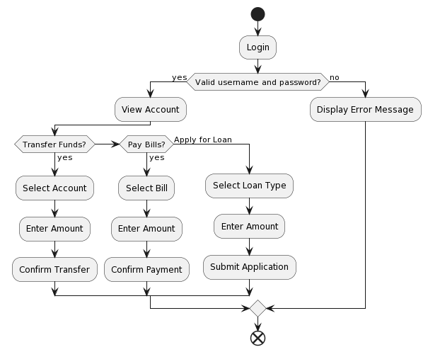
Activity diagram

Slide 11
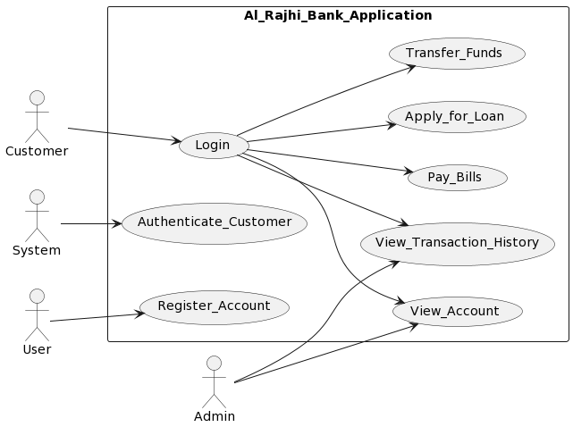
Use Case Modelling

Slide 12
Table 1
Actors | User , Customer , System , Admin
Description | User : actor represents a person who wants to create a new account with Al Rajhi Bank and access the Al Rajhi Bank Application as a 'Customer'. Customer : actor represents a user who already has an account with Al Rajhi Bank and uses Al Rajhi Bank Application to manage their bank account, perform transactions, and access banking services. System : actor represents Al Rajhi Bank Application itself, which is a software system developed and maintained by Al Rajhi Bank to provide online banking services to its users. Admin : actor represents a user with administrative privileges who is responsible for managing and maintaining Al Rajhi Bank Application.
Data | Customers , payments , Products , Remittances
Stimulus | The user can see some services within the app and can add some products to the cart, they can be purchased after creating your account
Response | The user enters Al-Rajhi Bank application and searches for the services or products that he wants, and they are available for viewing only
Comments | There must be privacy for each customer, as other customers cannot monitor the customer's bank account, transfers, and employees cannot dispose of the customer's account at all.

Slide 13
Table 2
Actors | User , Customer , System , Admin
Description | User : actor represents a person who wants to create a new account with Al Rajhi Bank and access the Al Rajhi Bank Application as a 'Customer'. Customer : actor represents a user who already has an account with Al Rajhi Bank and uses Al Rajhi Bank Application to manage their bank account, perform transactions, and access banking services. System : actor represents Al Rajhi Bank Application itself, which is a software system developed and maintained by Al Rajhi Bank to provide online banking services to its users. Admin : actor represents a user with administrative privileges who is responsible for managing and maintaining Al Rajhi Bank Application.
Data | Customers , payments , Products , Remittances
Stimulus | The customer can view all the services within the application and can add some products to the shopping cart, he can buy them and he can make bank transfers
Response | When the customer logs into the Al-Rajhi Bank application, it shows below the latest transactions that were conducted in his bank account, and he can inquire about his banking information in the application and make transfers about and purchase some goods in the application’s store
Comments | There must be privacy for each customer, as other customers cannot monitor the customer's bank account, transfers, and employees cannot dispose of the customer's account at all.

Slide 14
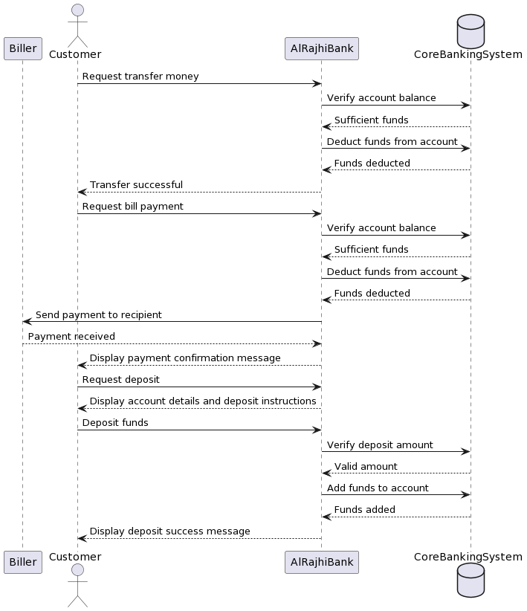
Sequences diagram

Slide 15
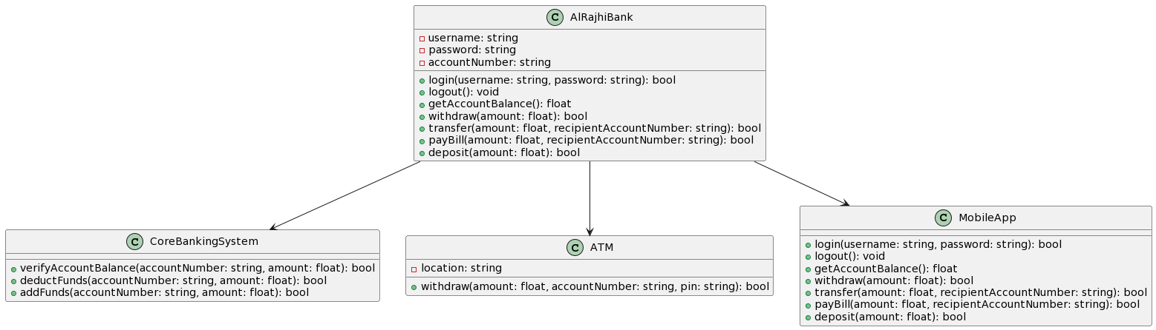
Class diagram

